Slide 1

Skin Cancer Classification

Slide 2
Overview
Introduction
Dataset and EDA
Data preprocessing
ML Models
Web App
Conclusions

Slide 3
Introduction
Skin Cancer
Image Classification
Prevalence
Skin cancer is one of the most common types of cancer globally.
Early Detection
Early detection is crucial for successful treatment and improved outcomes.
Visual Diagnosis:
Dermatologists often rely on visual inspection for diagnosis, making it a suitable candidate for image classification.
Overview
Image classification is a machine learning technique that assigns predefined labels or categories to images.
How
Using deep Neural Networks, can classify skin lesions faster and potentially more accurately than healthcare professionals.
Why
This would save time and reduce strain on resources.

Slide 4
Introduction
Skin Cancer
Image Classification
Prevalence
Skin cancer is one of the most common types of cancer globally.
Early Detection
Early detection is crucial for successful treatment and improved outcomes.
Visual Diagnosis:
Dermatologists often rely on visual inspection for diagnosis, making it a suitable candidate for image classification.
Overview
Image classification is a machine learning technique that assigns predefined labels or categories to images.
How
Using deep Neural Networks, can classify skin lesions faster and potentially more accurately than healthcare professionals.
Why
This would save time and reduce strain on resources.

Slide 5


Technologies Used
ML
Web App

Slide 6
Dataset - Skin Cancer MNIST: HAM10000
HAM10000 ("Human Against Machine with 10000 training images") dataset. Publicly available and not identifiable. Available from: https://www.kaggle.com/datasets/kmader/skin-cancer-mnist-ham10000
Contains labelled images of the 7 most important diagnostic categories of skin lesions:
Actinic keratoses
Basal cell carcinoma
Benign keratosis-like lesions
Dermatofibroma
Melanoma
Melanocytic nevi
Vascular lesions
Also contains the patients age, gender and the localization of the lesion.

Slide 7
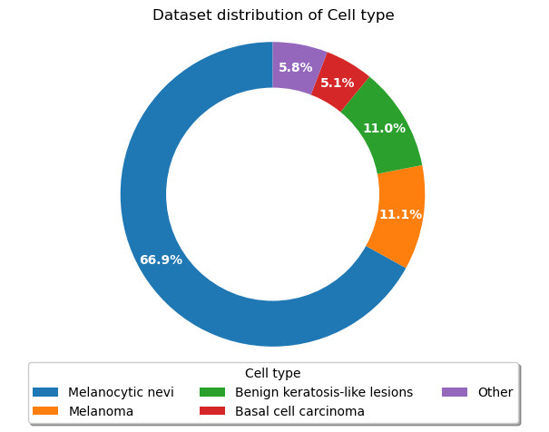
EDA – Lesion type

Slide 8
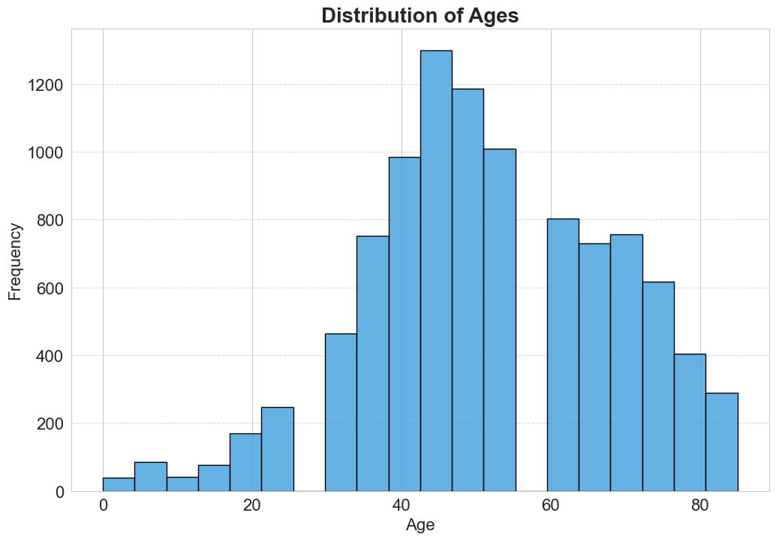
EDA – Age

Slide 9
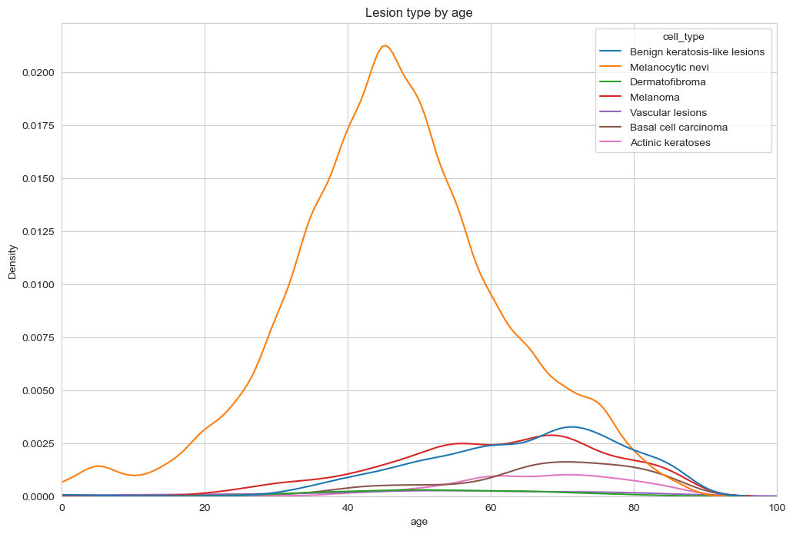
EDA – Age and lesion type

Slide 10
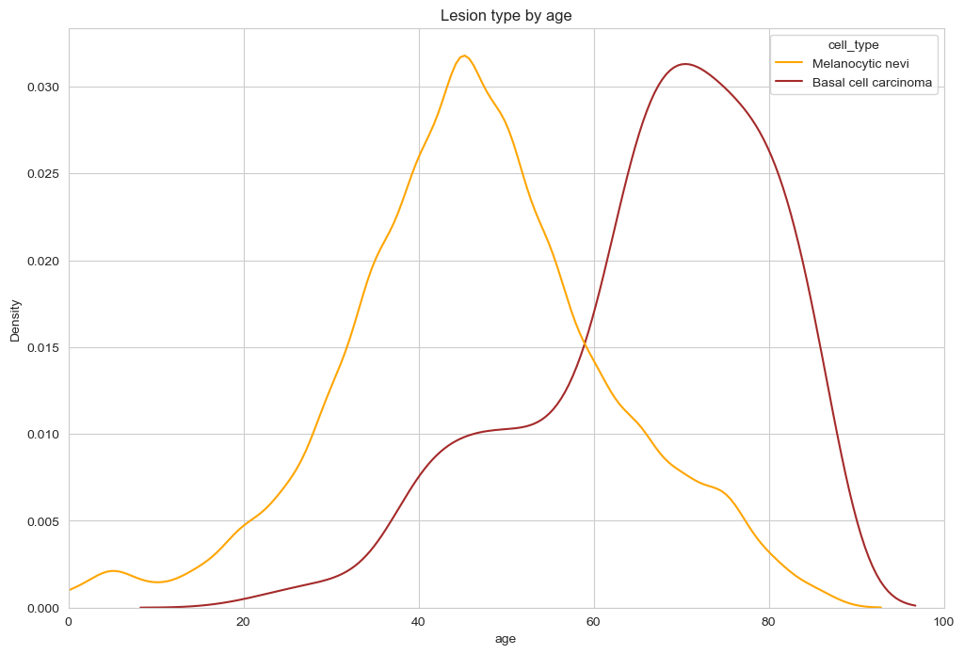
EDA – Age and lesion type

Slide 11
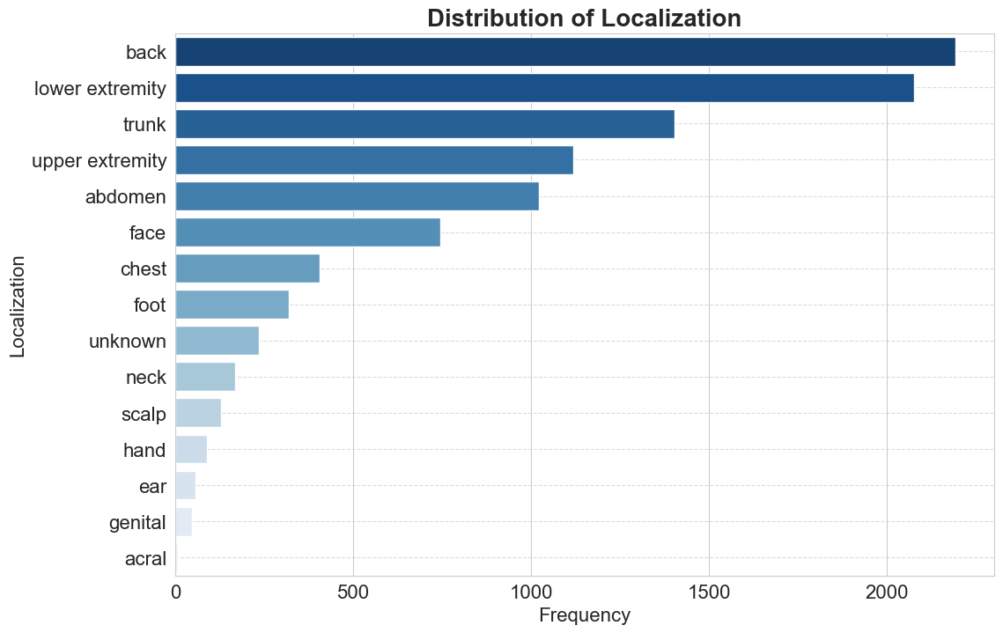
EDA – Localization
Notes:
Rotate images

Slide 12
Data Preprocessing
Dataset was very clean, only had NaN values in Age column (0.5%). Filled these with the mean.
Resized images to be more manageable (100x75 pixels)
Train/Validation/Test split
Data Augmentation

Slide 13
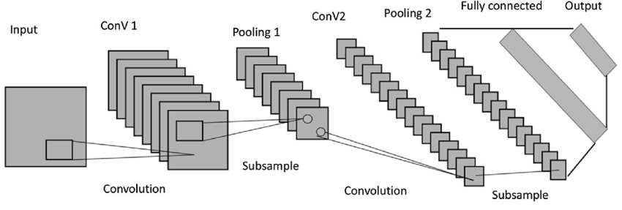
ML Models - Overview
Convolutional Neural Networks (CNNs) are a class of deep learning models specifically designed for processing and analyzing visual data.

Slide 14
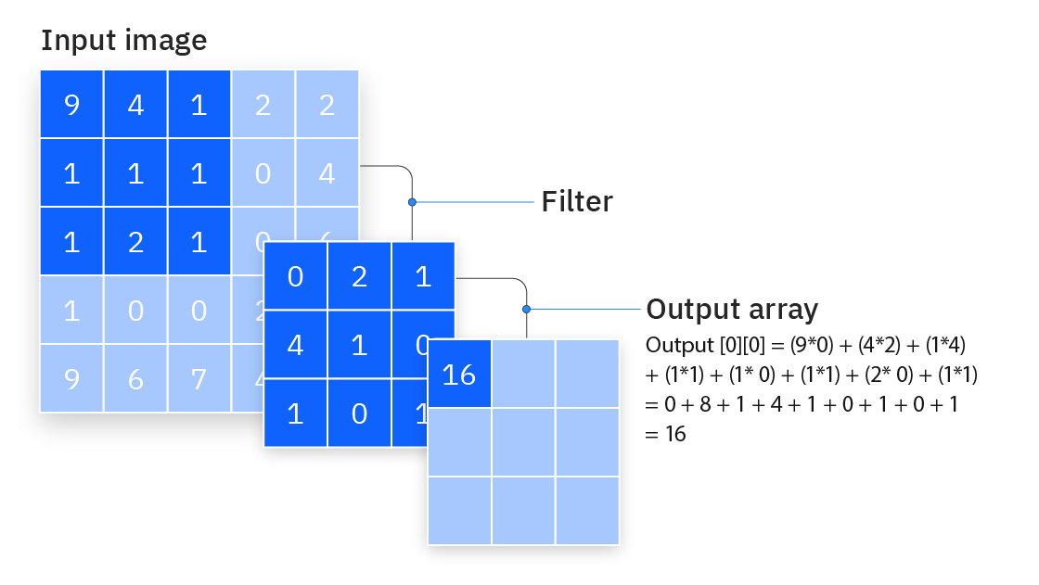
ML Models – Convolutional Layers

Slide 15
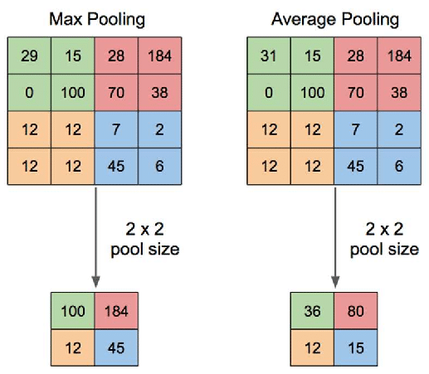
ML Models – Pooling Layers

Slide 16

ML Models – Dropout

Slide 17
ML Models - Overview
Convolutional Neural Networks (CNNs) are a class of deep learning models specifically designed for processing and analyzing visual data.

Slide 18
Model Performance

Slide 19
Model Summary
Architecture | Input | Output | Parameters
CNN Binary | Image | Cancerous vs Non-Cancerous | 3,752,354
CNN | Image | Lesion type | 3,752,999
VGG16 | Image | Lesion type | 14,911,815
MobileNet | Image | Lesion type | 2,266,951
Multi-input | Image, Age, Gender and Localization | Lesion type | 3,081,947

Slide 20
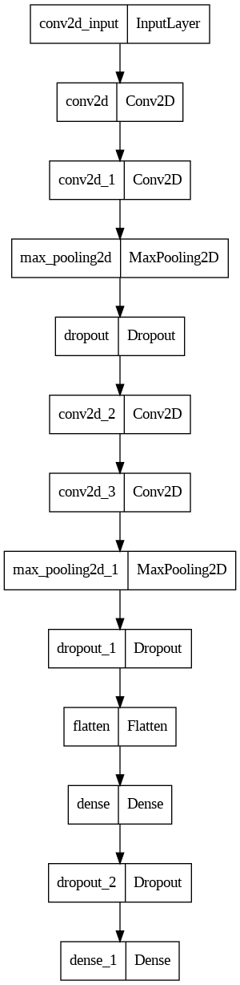
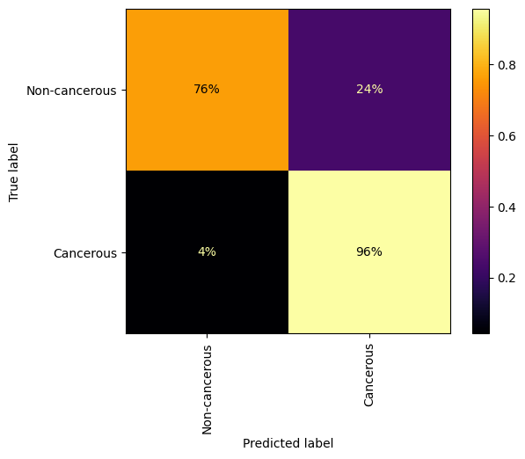
ML Models – Binary CNN

Slide 21
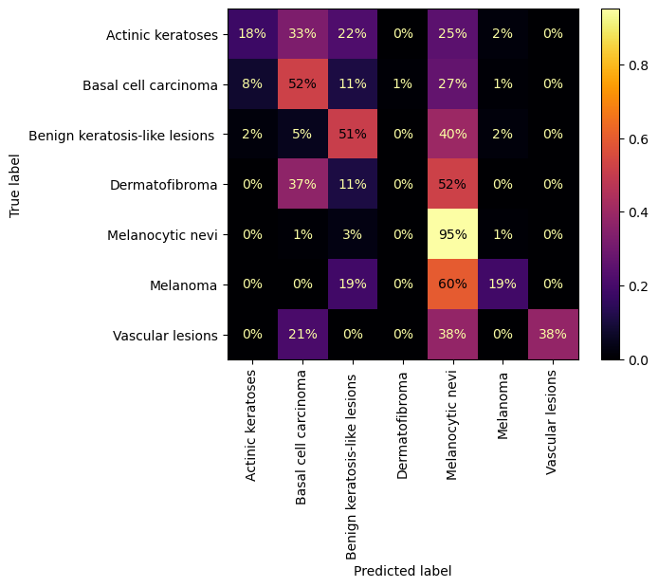
ML Models – CNN

Slide 22
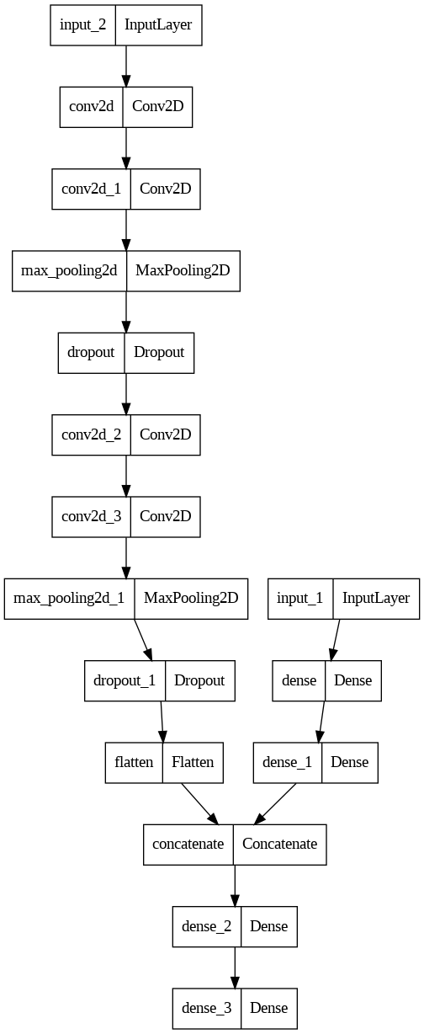
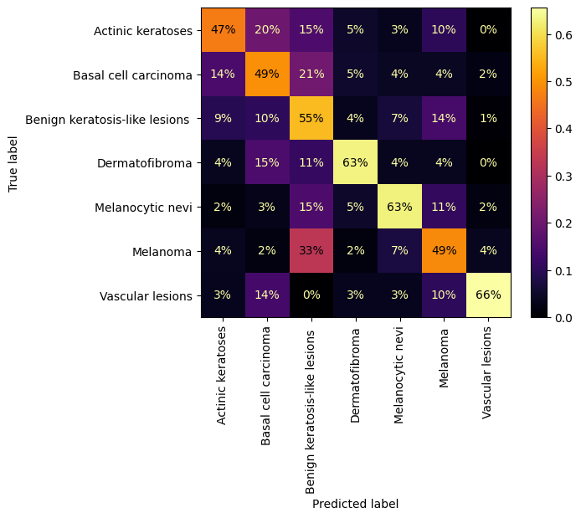
ML Models – Multi-Input*

Slide 23
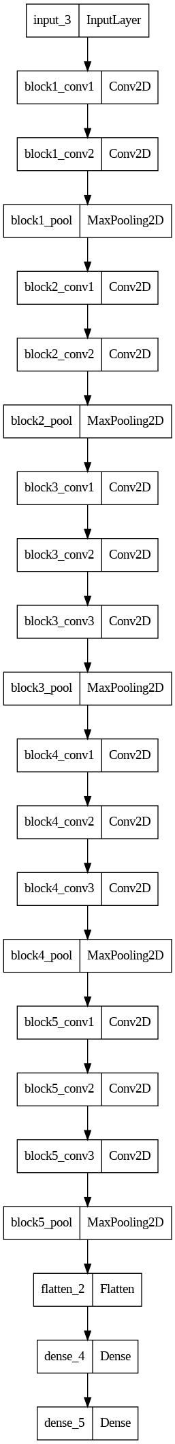
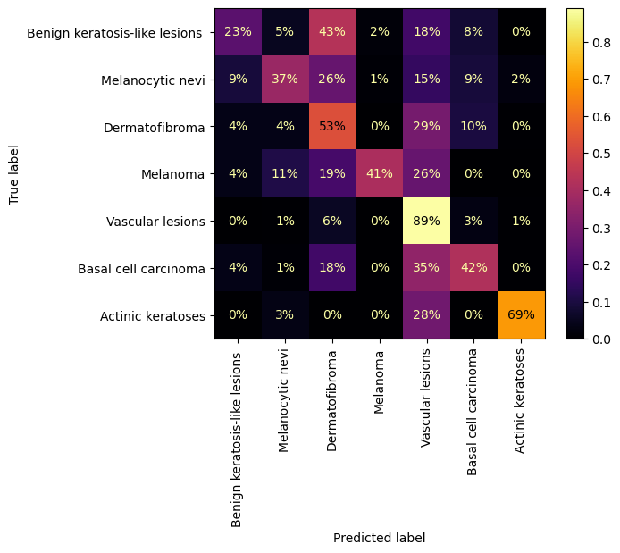
ML Models – VGG16

Slide 24
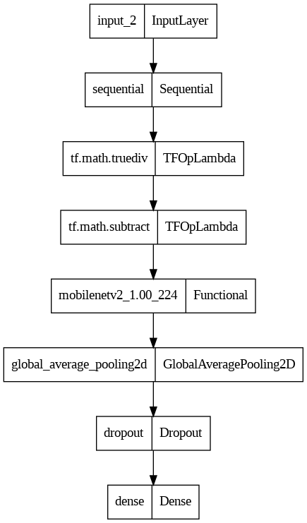
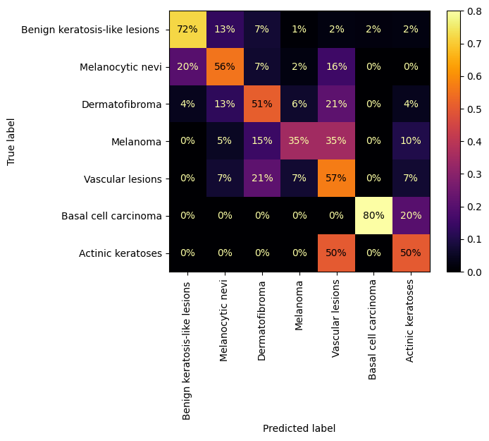
ML Models – MobileNet*

Slide 25
What are the models looking for?
To better understand what the model is looking for I have used the gradient-weighted class activation mapping (Grad-CAM) technique.
Grad-CAM is a visualization technique used to interpret the decisions made by machine learning models. It highlights the regions in an input image that are important for a model's prediction.
Why is this useful?
Identifies potential issues and biases in the model's learning patterns.
Validates whether the model is focusing on relevant features.

Slide 26
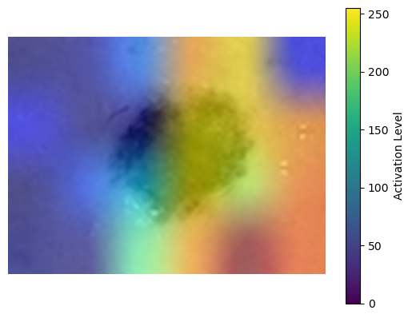
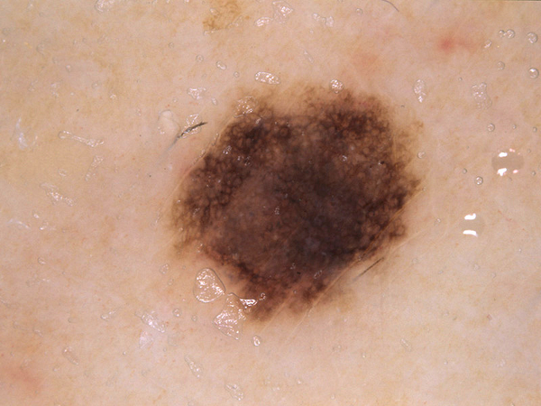
What are the models looking for?
Input Image
Model Activation (VGG)

Slide 27
Web App
Created Flask App in Python.
Allows users to see EDA and model comparison.
Select a model and upload an image to have it classified.

Slide 28
Web App
Demonstration

Slide 29
Future Work
Apply resampling or weighting to all models to combat imbalance.
Fine tune all models to improve performance.
Improve report generation (Grad-CAM) in the Flask app.
Launch Flask app to be available for use.

Slide 30
Conclusions
Used HAM 10000 Skin Lesion dataset.
Explored dataset, discovering an imbalance.
Compared several ML models performance on the dataset.
Produced flask app for easy use of models for lesion classification.

Slide 31

Any questions?

